Slide 1
ExtJS and Seam Part One
Drew Tayman

Slide 2
Outline
Javascript background
ExtJS hierarchy and component model
ExtJS advanced topics
Seam WebRemoting introduction
Tying ExtJS and Seam together

Slide 3
Javascript Background

Slide 4
JavaScript Background
Also known as ECMAScript.
Originally used by Netscape in 1995, not related to Oracle’s JAVA, each browser implements its own interpreter
4 major features
Prototype-based object-oriented
Dynamic
Weakly typed
First-class functions.

Slide 5
What is ExtJS
A JavaScript framework originally developed as an extension of Yahoo YUI
Also includes interoperability with jQuery and Prototype
Differentiates itself with a mature set of ready-to-use components that share a common API

Slide 6
1. It is Prototype-based Object-Oriented
In Class-based OO programming behavior reuse happens through inheritance.
In Prototype-based languages “inheritance” happens by cloning existing objects that serve as prototypes.
public class MockForcingMechanismsGraphsBackingBean extends ForcingMechanismsGraphsBackingBean implements Serializable {
//logic
}
//the object notation is {}
//instantiate a copy of Object with two properties
var foo = {one: 1, two: 2};

Slide 7
JavaScript Inheritance Cont.
Every object implicitly extends Object, a base “template” object that you extend with your own logic. Object contains a child object called Prototype that is used to create properties and methods shared across all instances of an object.
Classes you implement can define their own prototype logic related to initialization. For example you may want to define a class of objects called ‘tables’ that share some common rendering logic.
By tying into object prototypes you can focus on the differences between components and generalize common functions into parent objects.

Slide 8
JavaScript Inheritance Cont.
Here’s a basic prototype example. We have added a method to the pet prototype called ‘sayHello.’ The method will be shared with all instances of Pet. As such you should not put any instance-specific information in a prototype.
function Pet(name, species, hello){
this.name = name;
this.species = species;
this.hello = hello;
}
Pet.prototype.sayHello = function(){
alert(this.hello);
}
var rufus = new Pet("Rufus", "cat", "miaow");
rufus.sayHello();

Slide 9
JavaScript Inheritance Cont.
There’s more to ECMAScript–based inheritance, but fortunately a deeper discussion is not necessary since ExtJS provides its own inheritance mechanisms.
In ExtJS-based inheritance you extend an existing Object with your own code.

Slide 10
Extending Classes
Extension is used whenever you would like to add functionality to an existing class
A basic implementation requires 2 things
The definition of a function that calls the parent’s constructor
A call to Ext.extend to create the subclass and optionally override members.
Ext.ux.data.SeamWebRemoteReader = function(config) {
Ext.ux.data.SeamWebRemoteReader.superclass.constructor.call(this, config);
};
Ext.extend(Ext.ux.data.SeamWebRemoteReader, Ext.data.JsonReader, {
readRecords : function(input) {
return Ext.ux.data.SeamWebRemoteReader.superclass.readRecords.call(this, input);
}
});

Slide 11
Extending Classes (cont)
Its very important to remember that you are defining a prototype – you need to be explicit about whether you are defining instance or static data
var MyPanel = Ext.extend(Ext.Panel, {
somePrototypeProperty: 'foo', //will be created ONCE and shared in every instance
constructor: function (config) {
Ext.apply(this, config);
MyPanel.superclass.constructor.call(this);
}
});
var MyPanel = Ext.extend(Ext.Panel, {
this.somePrototypeProperty: 'foo', //will be created per instance
constructor: function (config) {
Ext.apply(this, config);
MyPanel.superclass.constructor.call(this);
}
});

Slide 12
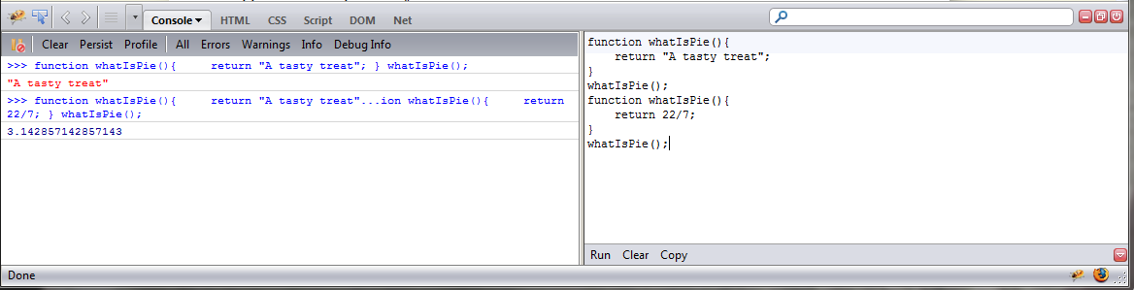
2. It is Dynamic
JavaScript executes at runtime and does not compile.
That means that you can modify / redefine your code while it is running (for example in FireBug).

Slide 13
How to leverage dynamic code with ExtJS Override
Remember that extension lets you create a new class based on a pre-existing ‘template.’
Overrides let you modify an existing class and redefine methods / data. This is possible since JavaScript is dynamic and is executed on-the-fly.
Overrides can be very dangerous since libraries not under your control can be changed.

Slide 14
Ext.override (cont)
Let’s say that you would like some code to execute whenever someone “hides” a window on your page.
You could use extend and create a subclass of Ext.Window and implement all of your components such that they call your new window code. However you will most likely bring some 3rd-party components on to your screen. Each of these components would need to be modified to use your new code. Furthermore any future developers would need to know about your special window extension if they want to add content to your page.

Slide 15
Ext.override (cont)
Solution: simply override Ext.Window with your own logic.
That way you can make sure your code is always executed and you don’t need to make any modifications to existing / future code.
Ext.override(Ext.Window, {
hide: function() {
// the contents of this function are now
//called instead of the default window hide function
}
});

Slide 16
Overriding Classes (cont)
As previously mentioned, overrides can be very dangerous since you are making assumptions about internal functionality within a component.
One way to mitigate risks associated with overriding is to use an anonymous function with a closure
One definition of a closure is “an expression where inner functions are made accessible outside of the function in which they are contained, so that they may be executed after the outer function has returned. When they are executed they still have access to the local variables, parameters and inner function declarations of its outer function.”
This may make more sense after we discuss scope. The following is outside the scope of this tutorial and is intended more as a reference.

Slide 17
Overriding Classes (cont)
Ext.override(Ext.Window, {
hide: function() {
// the contents of this function are now
//called instead of the default window hide function
}
});
The below function is executed immediately. The closure lets you keep a reference to the original hide function for Ext.Window. We use apply() to call the original function with the window’s scope and the arguments passed to our function.
(function() {
var originalHide = Ext.Window.prototype.hide;
Ext.override(Ext.Window, {
hide: function() {
//perform pre-processing
alert("The window is about to close!");
//call the original hide function
originalHide.apply(this, arguments);
//perform post-processing.
alert("The window closed!!1");
}
});
})();

Slide 18
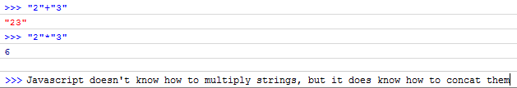
3. It is weakly typed
JavaScript is an un-typed language, meaning data types are not explicitly specified (its kind of like using void* in c/c++). A variable’s type is derived and applied dynamically during execution.
JS has 5 primitive types: string, number, boolean, null, and undefined. It also has 3 data types: array, function, and object.
It’s super easy to get yourself in trouble if you’re careless

Slide 19
Weak typing (cont)
As a result of weak typing, Ext has provided a variety of functions to help you determine what type of information is inside a variable
Ext.isDate
Ext.isEmpty
Ext.isBoolean
Ext.isArray
Ext.isFunction
…
The point is that its usually a better idea to look for a library function to help you with typing than to code it yourself since typing can often vary from browser to browser.

Slide 20
4. It has First Class Functions
Means you can pass functions as arguments to other functions, return them from other functions, and store them in data structures.
Also means you need to be vigilant about managing scope or you will get yourself into trouble (more on that later).
function add( firstNumber, secondNumber, fun ){
fun(firstNumber+secondNumber);
}
add(1,2,function(x){alert(x);});

Slide 21
ExtJS Hierarchy

Slide 22
ExtJS Hierarchy
ExtJS components (forms, grids, date pickers, etc.) depend on several supporting classes to implement functionality.
ExtJS was written with Separation of Concerns in mind. Components in ExtJS should be separated into distinct features that overlap in functionality as little as possible.
That means that a component responsible for presenting content, for example, should not need to know the mechanics of how the data is retrieved or stored inside the computer.

Slide 23
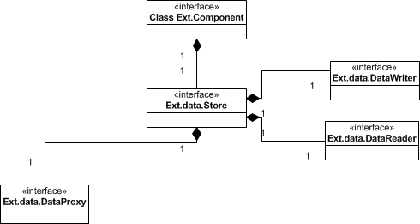
ExtJS Hierarchy

Slide 24
ExtJS Hierarchy Explained
A component is the atomic class for all UI elements in ExtJS. Everything (buttons, color pickers, charts) that is drawn will ultimately extend this class.
A store encapsulates the client-side cache of record objects which provide input data for components.

Slide 25
ExtJS Hierarchy Explained (cont)
Datawriters facilitate Create, Update, and Delete actions between a store and the backend
Datareaders define the mechanism by which structured data is converted into record objects for use by a store.
DataProxies define how data should be sent back and forth between the client and the server (ajax, xml…)

Slide 26
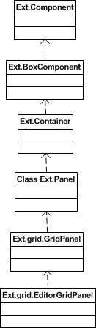
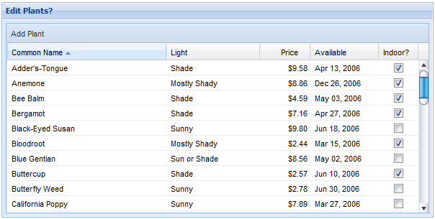
What does a real component look like?

Slide 27
That looked pretty complicated
A major advantage of ExtJS is the common API that all components share. It is very obvious by following the object hierarchy where functionality is added to components.
It also means that subcomponents can be interchangeable. Once you develop a plugin you can reuse it anywhere else in your code.
There is great documentation on Sencha’s website http://dev.sencha.com/deploy/dev/docs/

Slide 28
Simple ExtJS Grid Example
Walk through the process of setting up a simple read-only table in ExtJS
First pick the component. Go to the ExtJS example page (http://dev.sencha.com/deploy/dev/examples/) and pick the component (basic array grid).
The nice thing about the examples page is that non-technical people can get an idea about the framework’s capabilities without developers needing to code examples themselves.

Slide 29
Basic Array Grid
The logic will always be inside the Ext.onReady(function(){ }); block. It defines the code that should be executed once the DOM is ready (i.e. the page is finished loading).
Examples will almost always be self-contained and use built-in data (in the form of an array) rather than requesting data from a server.

Slide 30
The Data
In this case the data we want to display is an array of companies and their stock prices. The array is composed of a string, 3 numbers, and another string that represents a date.
var myData = [
['3m Co',71.72,0.02,0.03,'9/1 12:00am'],
['Alcoa Inc',29.01,0.42,1.47,'9/1 12:00am'],
['Altria Group Inc',83.81,0.28,0.34,'9/1 12:00am'],
['American Express Company',52.55,0.01,0.02,'9/1 12:00am'],
['American International Group, Inc.',64.13,0.31,0.49,'9/1 12:00am'],
['AT&T Inc.',31.61,-0.48,-1.54,'9/1 12:00am']
];

Slide 31
The Store
Since we are reading an array of data, we should use an ArrayStore to hold the records.
Many stores have ‘default’ readers that can be used to reduce the amount of code written. Below the ArrayStore is using its built-in ArrayReader to parse data.
Note how the dateFormat is defined inline with the store definition. You can define several other properties for the data you read in, such as converters, dependencies, and mappings.
var store = new Ext.data.ArrayStore({
fields: [
{name: 'company'},
{name: 'price', type: 'float'},
{name: 'change', type: 'float'},
{name: 'pctChange', type: 'float'},
{name: 'lastChange', type: 'date', dateFormat: 'n/j h:ia'}
]
});

Slide 32
The Grid
The grid brings in the store, sets up its columns, defines some layout properties, then renders itself into a div called ‘grid-example’
var grid = new Ext.grid.GridPanel({
store: store,
columns: [
{id:'company',header: "Company", width: 160, sortable: true, dataIndex: 'company'},
{header: "Price", width: 75, sortable: true, renderer: 'usMoney', dataIndex: 'price'},
{header: "Change", width: 75, sortable: true, renderer: change, dataIndex: 'change'},
{header: "% Change", width: 75, sortable: true, renderer: pctChange, dataIndex: 'pctChange'},
{header: "Last Updated", width: 85, sortable: true, renderer:
Ext.util.Format.dateRenderer('m/d/Y'), dataIndex: 'lastChange'}
],
height:350,
width:600
});
grid.render('grid-example');

Slide 33
Basic Grid Summary
The complexity involved in displaying a table on the screen was abstracted away from the developer.
Due to its pluggable nature, any individual piece could be replaced (for example using a grid that pages).
The code didn’t contain a single line of HTML or CSS.

Slide 34
Some More Advanced JS Topics
Events
Xtemplates
XTypes
Managing scope

Slide 35
ExtJS Events
There are 2 major categories of events: DOM events and JavaScript events
DOM events are fired by the browser when the user takes some action (like clicking on a button)
JavaScript events are ‘artificial’ events used by ExtJS components to provide more granularity and control over what’s happening in the UI. These events allow programmers to simply express an interest in a meta event like “the user successfully edited a cell in a table” rather than parsing all the DOM events themselves.

Slide 36
DOM Events
Ext simply wraps the DOM event and passes it through to listeners
Here’s what a DOM event would look like normally
And an example of Ext wrapping the same event
Its really nothing special… the only real advantage you get is better separation of HTML from JavaScript since you don’t have to code inline
<div id="mydiv" onclick="alert('You clicked me')">Click me!</div>
Ext.get('mydiv').on('click', function() {alert('You clicked me');});

Slide 37
JavaScript Event Sources
JavaScript events requires two parts: an event source and an event listener
Event sources are any Ext class that extends Ext.util.Observable (almost every built-in component already does)
Programmer = Ext.extend(Ext.Panel, {
initComponent:function() {
// call parent init component
Programmer.superclass.initComponent.apply(this, arguments);
// add custom events
this.addEvents('codeReview', 'readReddit');
}
,codeReview:function(otherProgrammer, codeReview) {
// do whatever is necessary review the code
// fire assigned event
this.fireEvent('codeReview', this, otherProgrammer, codeReview);
}
,readReddit:function(articleUrl) {
// load article into browser
// fire dismissed event
this.fireEvent('readReddit', this, articleUrl);
}
});

Slide 38
JavaScript Event Listeners
Listeners are registered to instances of an object
Generally you should add listeners inside your initComponent method
When an event is fired, Observable will call each listener in the order they registered
//install event listener
programmer.on('codeReview', function(panel, otherProgrammer, codeReview) {
alert(otherProgrammer+"'s code was just reviewed");
});
//install event listener
programmer.on('readReddit', function(panel, articleUrl) {
alert(articleUrl+“ is being viewed");
});

Slide 39
XTemplates
XTemplates allow template html to be populated with values from JavaScript.
Typically you define some html in a template file that is styled as display:none.
You then ui:include the template code and invoke Xtemplate with the values you wish to apply.

Slide 40
XTemplate Example
In this example we’re going to define a template div, and a target div
We’re then going to inflate the template with an error message when the code is executed
<div id="errorPanel" style="width: 100%" />
<div id="errorPanelTemplate" style="overflow: hidden; width: 100%; display: none">
<span class="rich-messages-marker">
<img src="/img/error.gif" style="margin-right: 4px;" />
</span>
<span class="rich-messages-label">{message}</span>
</div>
function(errorMsg) {
//display an error
var dataview = new Ext.XTemplate.from("errorPanelTemplate");
dataview.overwrite("errorPanel", errorMsg);
}

Slide 41
XTemplates Conclusion
There are a lot of advanced features not shown concerning XTemplates including conditional processing, basic math function support, inline code execution against template variables, and built-in operators (like iterators)
Using XTemplates means that you don’t have to mix HTML markup inside JavaScript logic. It will make your code cleaner and allow easier modifications to look and feel.

Slide 42
XTypes
An XType is simply a symbolic name given to a class. So rather than referring to a class as Ext.ux.CustomThing you can register it as a type and refer to it using short hand
They’re useful because they allow lazy initialization. You may have a page with hundreds of controls but only a few are usually shown, resulting in the wasting of a lot of resources. If you define all those controls using Xtypes they will only be loaded when they are needed, resulting in a more responsive UI with less overhead.
Ext.reg(‘customThing', Ext.ux.CustomThing);
var myForm = new Ext.form.FormPanel({
...
items: [
{
xtype: 'customThing',
name: 'Really cool control',
}
...

Slide 43
Managing Scope In ExtJS
Scope management is a very important topic in JavaScript programming. Remember that JS has first-class functions that can be passed as arguments, returned from other functions, and stored in data structures. Consequently you have no control over when or where your code will be executed.
JS and ExtJS provide a number of mechanisms to help programmers need to explicitly define and manage scope within their code.

Slide 44
More on scope
You can think of this as a special (hidden) parameter to each and every function. JavaScript sets this whenever you call a function. It does that by a very simple rule: If the function is called as a direct member of an object (a.foo()), then this object is set as this. If the function is not a member of an object (foo()), then this is set to the global object (i.e. the window object in the browser).

Slide 45
Basic Scope Example
What happens when this code is executed?
var obj = {
toString:function(){ return 'in scope of obj';},
func: function(){
// this function is a direct member of "object"
console.log(this);
var innerFunc = function(){
// this function is not a direct member of an object, it
// is a variable in another function
console.log(this);
};
innerFunc();
}
};
obj.func();

Slide 46


Result?
The result is
As stated in the comment, since innerFunc is not a direct member, it’s this is the global window scope
JS provides a built-in method named call() to set the scope of methods you are invoking
Result?
var obj = {
toString:function(){ return 'in scope of obj';},
func: function(){
console.log(this);
var innerFunc = function(){
console.log(this);
};
innerFunc.call(this);
}
};

Slide 47
Ext Scope Convention
The convention used in Ext is that scope is optional and is always the last parameter in a method call. For example, suppose you have an array of objects and you want to perform an action on a specific element.
If you don’t pass in the scope the function will not have access to the doSomething() function or the doors array – they will be out of scope
var doors = new Array( );
doors[doors.length] = {type:"wood", size:"large", weightInPounds:100};
doors[doors.length] = {type:"steel", size:"medium", weightInPounds:300};
doors[doors.length] = {type:"plastic", size:"large", weightInPounds:50};
function doSomething(door){ /*do something*/ }
Ext.each(Ext.pluck(this.doors, ‘type'), function(curr, index) {
if ("wood" === curr) {
this.doSomething(this.doors[index]);
return false;
}
}, this);

Slide 48
createDelegate()
The createDelegate() function will ensure that a function’s this parameter is set to what is provided as an argument
It can be used when building callbacks
function(request) {
return function(response) {
if (request.action === "read") {
this.onRead(request, response);
} else {
this.onWrite(request, response);
}
}.createDelegate(this)
}

Slide 49
Seam WebRemoting
Seam Remoting provides a JavaScript framework that allows developers to access Java components from a web page.
Communication between the front end and the back end happens behind the scenes over XML-wrapped messages
Seam Remoting is by definition asynchronous – any calls you make will return immediately. You must register a callback if you want

Slide 50
WebRemote JavaBean
The only thing you have to do to make a seam component expose a method through remoting is add an annotation:
@Name(“helloWorldBean")
@Scope(ScopeType.CONVERSATION)
public class HelloWorldBean{
@WebRemote
public String sayHelloWorld(){
return "Hello World!";
}
}

Slide 51
WebRemote XHTML
A little more involved than the bean but still pretty straight forward.
You have to include each bean that you will be interacting with in <s:remote> tags
Again, since everything happens asynchronously you need to specify a callback to handle the return from the function.
<s:remote include=“helloWorldBean" />
<script type="text/javascript">
function getHello() {
Seam.Component.getInstance("helloWorldBean").sayHelloWorld(sayHelloCallback);
}
function sayHelloCallback(result) {
alert(result);
}
</script>
<a href='#' onclick="javascript:getHello()">Say Hello World</a>

Slide 52
Tying WebRemote and ExtJS Together
Neither ExtJS nor Seam have built-in mechanisms to work with each other.
Need to use the SeamWebRemoteProxy to give ExtJS ability to “reach back” and perform CRUD against Seam components.
May also need to use a store to handle all the special cases surrounding workgroup objects (“delete” either reverts an object or removes it from the database depending on its status).

Slide 53
Using a proxy
Previously we just had a store backed by an array
To use a proxy we simply pass one into our store (defined on the next page)
var store = new Ext.data.ArrayStore({
fields: [
{name: 'company'},
{name: 'price', type: 'float'},
{name: 'change', type: 'float'},
{name: 'pctChange', type: 'float'},
{name: 'lastChange', type: 'date', dateFormat: 'n/j h:ia'}
]
});
var store = new Ext.data.ArrayStore({
fields: [
{name: 'company'},
{name: 'price', type: 'float'},
{name: 'change', type: 'float'},
{name: 'pctChange', type: 'float'},
{name: 'lastChange', type: 'date', dateFormat: 'n/j h:ia'}
],
proxy: proxy
});

Slide 54
Defining a Proxy
var proxy = new Ext.ux.data.SeamWebRemoteProxy({
apiActionToHandlerMap : {
read : {
seamComponentName : “myCrudBean",
remoteMethod : "getTasks"
},
update : {
seamComponentName : “myCrudBean",
remoteMethod : "updateTasks",
beanName : “myTransferObject"
},
create : {
seamComponentName : “myCrudBean",
remoteMethod : "createTasks",
beanName : “myTransferObject"
},
destroy : {
seamComponentName : “myCrudBean",
remoteMethod : "deleteTasks",
beanName : “myTransferObject"
}
}
});

Slide 55
Additional Reading
Code Structure
http://www.sencha.com/forum/showthread.php?54537-code-structure&p=259901
Scope
http://www.sencha.com/learn/Tutorial:What_is_that_Scope_all_about
http://www.sencha.com/learn/Tutorial:What_is_that_Scope_all_about2

